Slide 1
weak bosons
-
composite
H. Fritzsch
LMU Munich

Slide 2
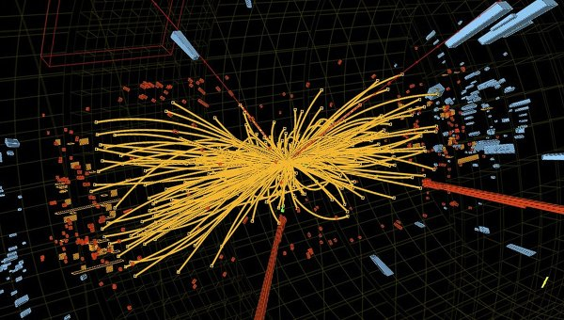
L H C
Z
???
126 GeV
Z

Slide 3
-
???
„Higgs“
boson

Slide 4
-
!!!
excited
weak boson
spin 0

Slide 5
-
weak bosons
composite

Slide 6
proton mass field energy (gluons and quarks)

Slide 7
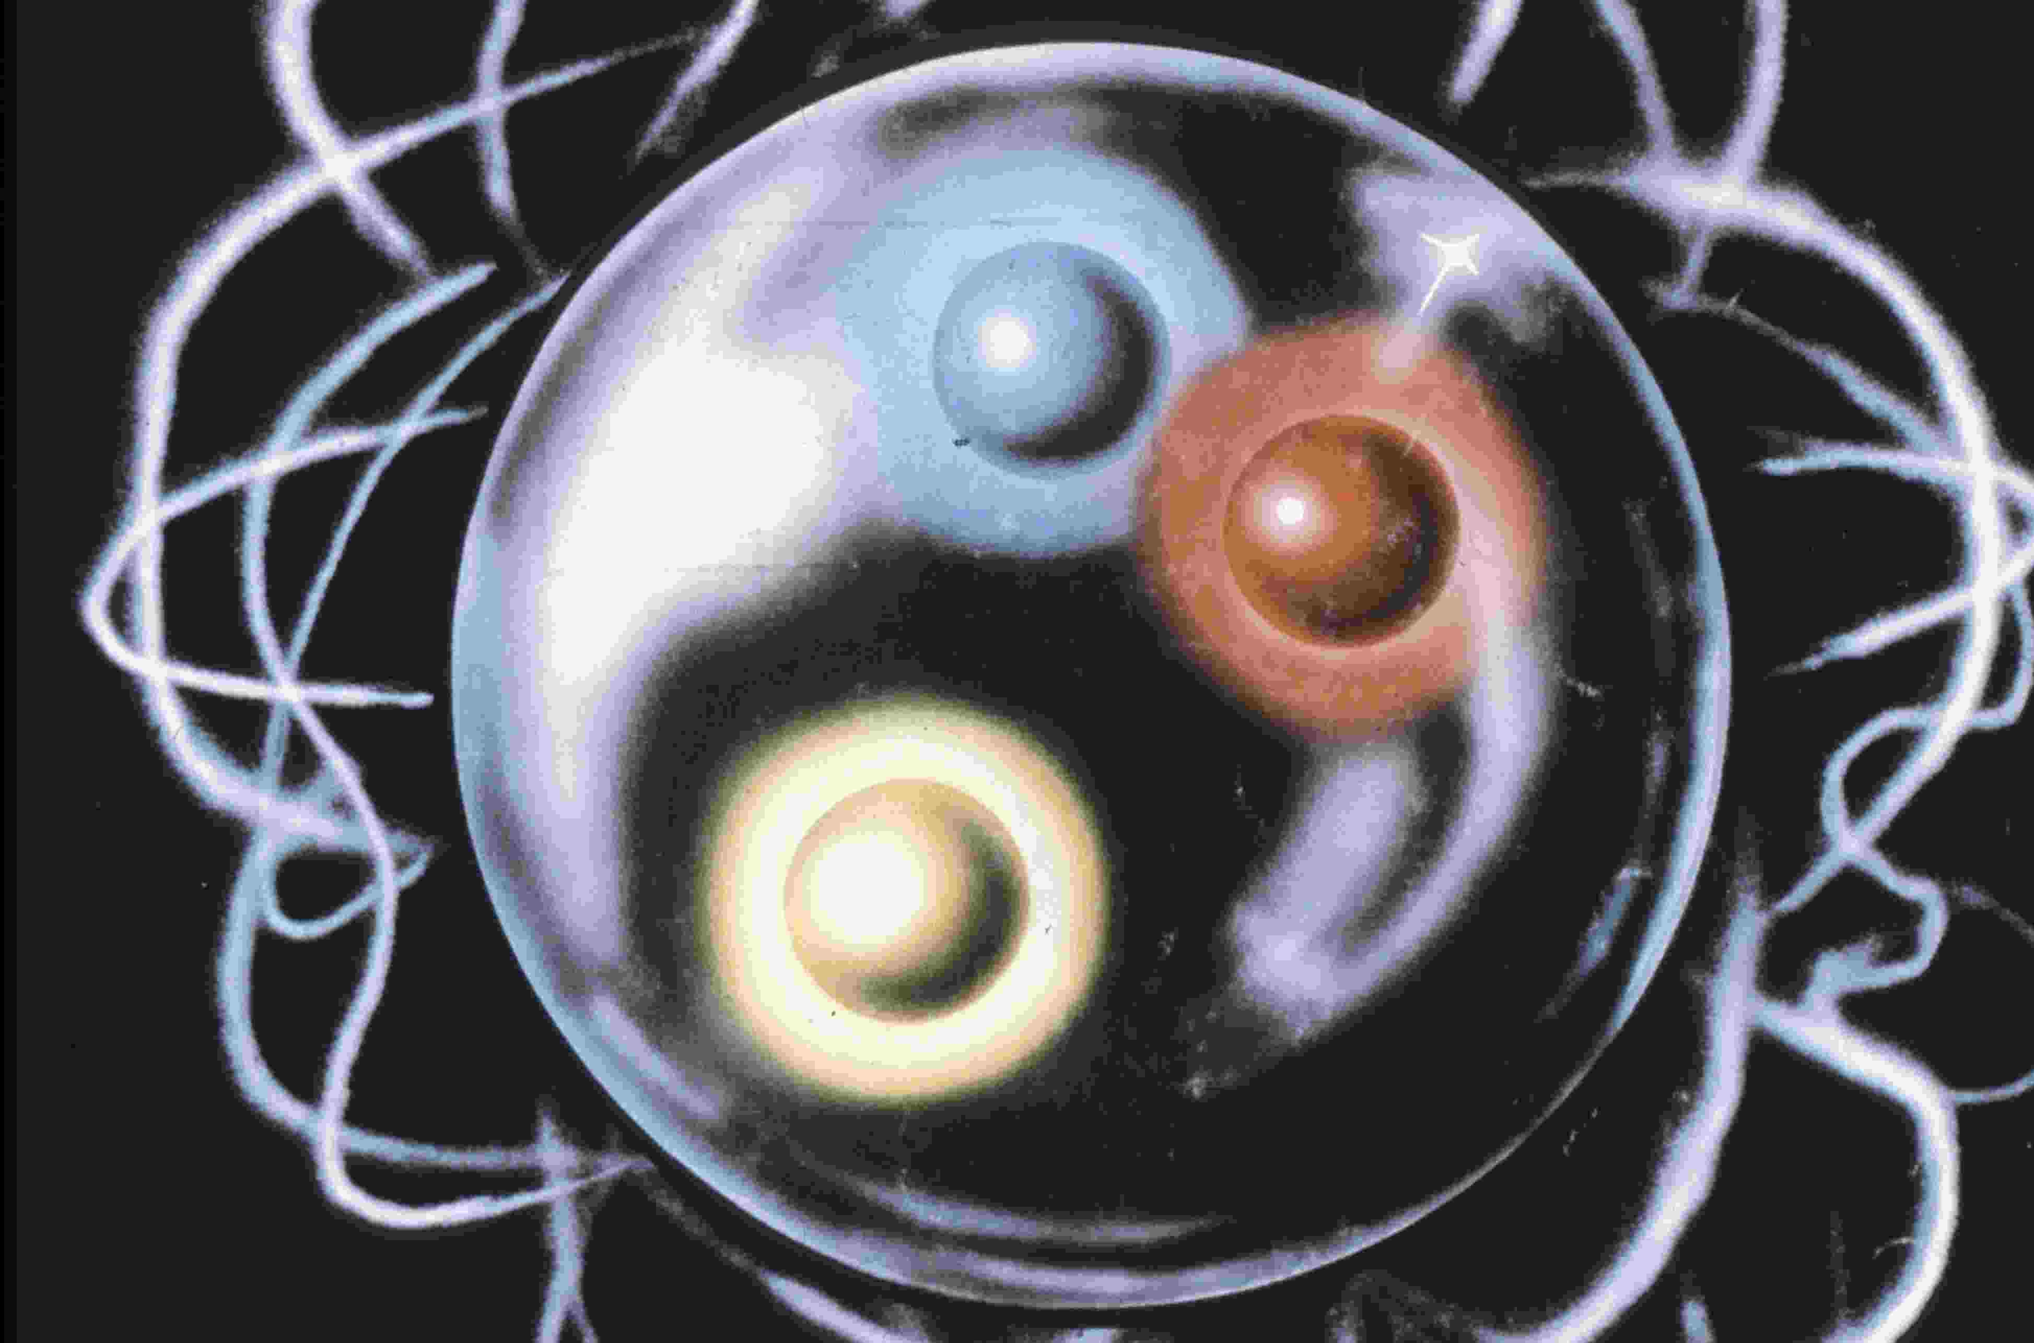

-

Slide 9
weak bosons
-
composite

Slide 10
-
analogy

Slide 11
1954=> C.N. Yang, R. Mills J. J. Sakurai rho mesons ➔ elementary gauge bosons

Slide 12
1964 mass generation rho mesons „Higgs“ mechanism

Slide 13
-
SU(2)
2 x 2 scalars
mass M
massless
rho - mesons

Slide 14
-
“Higgs“ - mechanism
„Higgs“ - scalar
mass M
massive
rho - mesons

Slide 15
rho – mesons
1964
Quark-antiquark …bound states….

Slide 16
-
Q C D
1 GeV
no „Higgs“ - scalar
massive
rho - mesons

Slide 17
-
no „Higgs“ - scalar
massive weak bosons

Slide 18

-
lefthanded fermions

Slide 19
haplos ⬄ simple

Slide 20
-
electric charges

Slide 21

-

Slide 22
-
haplons confined
by gauge force
QHD
chiral gauge theory

Slide 23
-
gauge group
of QHD
SU(2)

Slide 24
-
mass scale
of
QHD

Slide 27
-
Mixing
W-boson - photon

Slide 28
mixing parameter

Slide 29
-
~10.4 GeV

Slide 30
-
QHD

Slide 31
-
QHD + QED
~10.4 GeV

Slide 32

Standard Theory

Slide 33
-
W decay constant

Slide 34
-

Slide 35
-
-

Slide 36
c o m p l e x i t i e s
of
strong interactions
~ 1 G e V

Slide 37
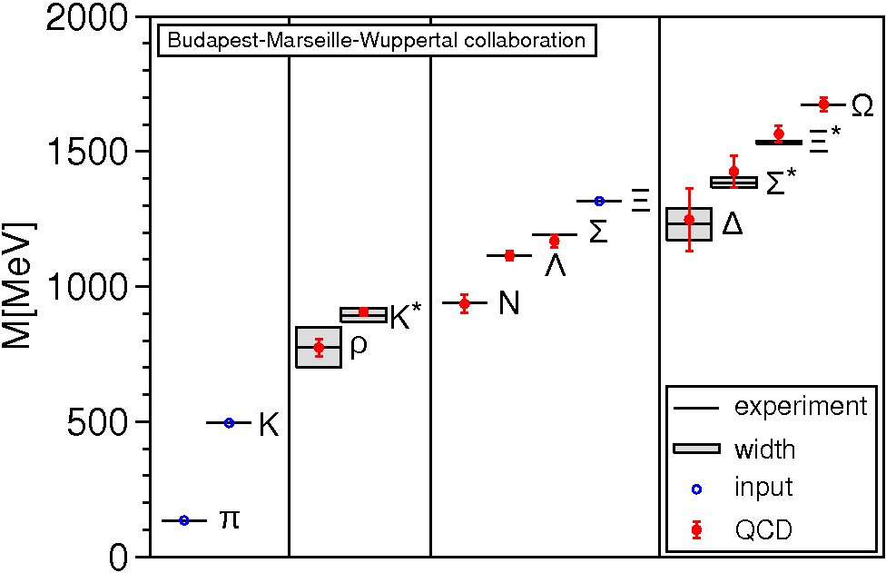

Slide 38
complexities
of
Q H D interactions
~ 1 TeV

Slide 39
Excited weak bosons

Slide 40
p-wave bosons
three SU(2) singlets
S(0) = 0 (0)
S(1) = 0 (1)
S(2) = 0 (2)

Slide 41
p-wave bosons
three SU(2) triplets
T(0) = 1 (0)
T(1) = 1 (1)
T(2) = 1 (2)

Slide 42
p-wave mesons ( QCD ) isospin singlets

Slide 43
isospin triplets in QCD

Slide 44
1 GeV
0.5 GeV

Slide 45
analogy

Slide 46
0.5 TeV
?
0.1 TeV

Slide 47
-
S(0)
LHC
126 GeV

Slide 48
S(0)
126 GeV

Slide 49
0.5 TeV
0.1 TeV

Slide 50
0.5 TeV
0.1 TeV

Slide 51
0.5 TeV
0.1 TeV

Slide 52
analogy

Slide 53
0.5 TeV
0.1 TeV

Slide 54
S(0) - decays

Slide 56
-
mass S(0) >> 2 M(W)

Slide 57
-
mass S(0) = 126 GeV < 2M(W)
phase space =>

Slide 58
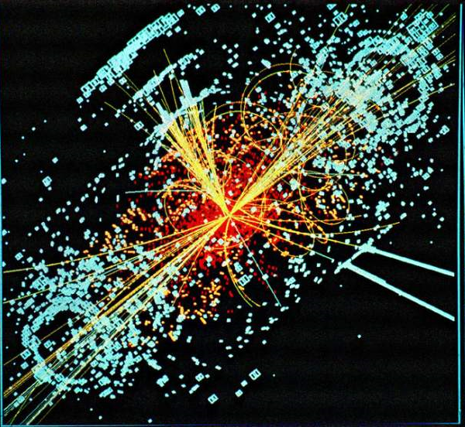
w
S(0)
W
100 %

Slide 59
Z
S(0)
Z
~55 %

Slide 60
S(0)
~5 %

Slide 61
S(0)
~ 4 %

Slide 62
CERN
S(0)➔ photon + Z
not yet observed
(< 5% )

Slide 63
-

Slide 64
-

Slide 65
D: H=2 => stable
Dark matter

Slide 67
gas of D-bosons

Slide 68
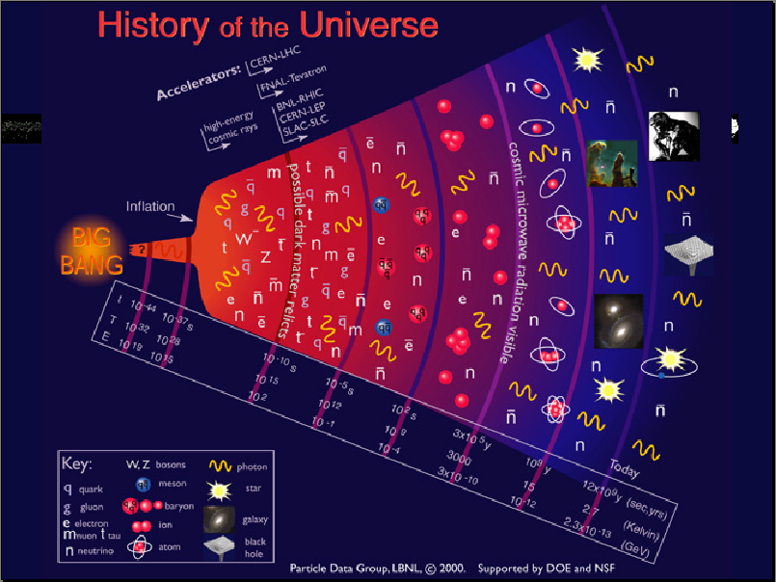
D
D

Slide 69
average local densityy of
dark matter in our galaxy:
D-mass ~ 1.5 TeV
===>
260 D-bosons in
a cubic meter

Slide 70
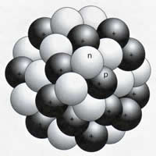
Z
D
M(D) > 1 TeV

Slide 71
p
p
missing energy > 2 TeV

Slide 72
-
Conclusions
weak bosons
composite

Slide 73
S(0)
126 GeV

Slide 74
-
S(0)
excited
weak boson
Spin 0

Slide 75
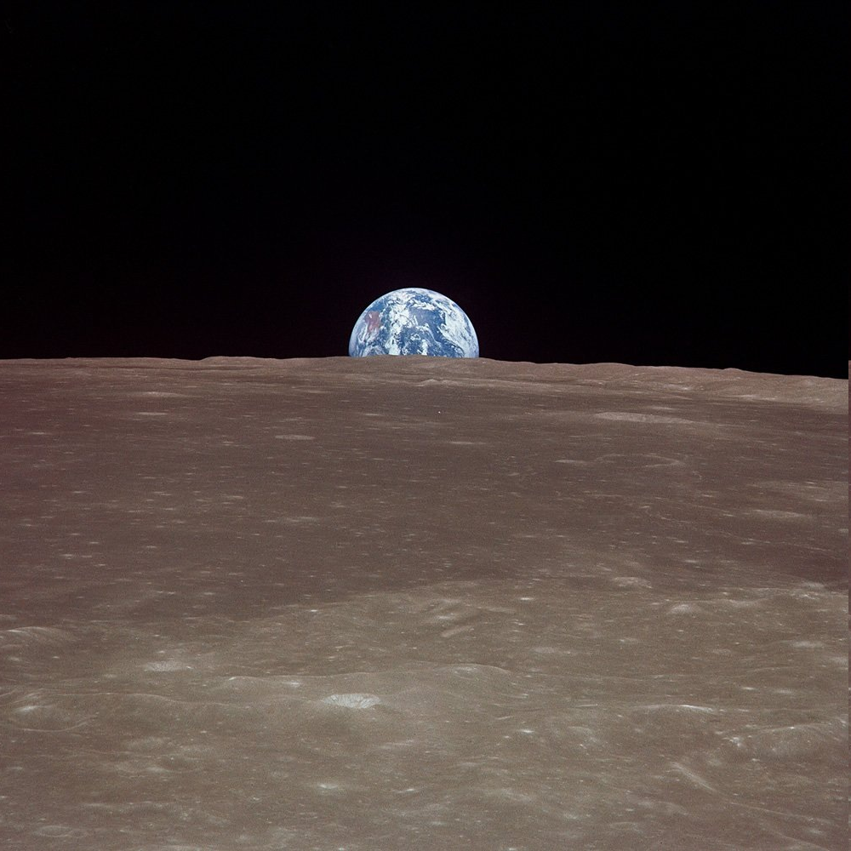
6 p-wave bosons
below 1 TeV
L H C

Slide 76
0.5 TeV
0.1 TeV

Slide 77
Dark Matter
gas of D-bosons

Slide 78
-
future
LHC

Slide 79
Z
)
2015

Slide 81
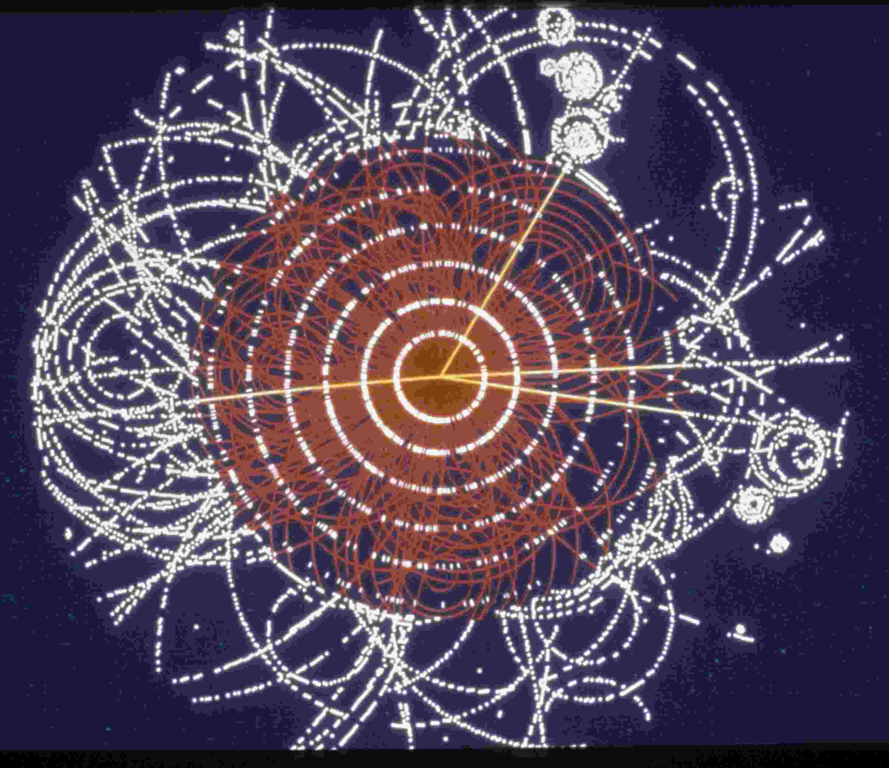

Slide 82
)
2017

Slide 83
LHC
QHD

